Slide 1


Slide 2
TECHSPARKSIT
Where we create beautiful amazing stuff……..

Slide 3
…YOU
If you have a hunger to align your business with changing technological trends of today, our wide range of Web services can make it a pleasant journey of innovative and creative fulfillment for both you and us.
You are an extremely important part of Us and the process it takes to serve you.

Slide 4


Slide 5
“YOUR BUSINESS IS OUR BUSINESS”

Slide 6

OUR VISION
To be recognized as a leader in Web services and to be loved by our clients and staff.

Slide 7

Is to set an example in online environment by providing creative and innovative ideas and solutions to all your needs
OUR MISSION

Slide 8

WHAT MAKES US
STAND OUT
We are...
Passionate:
We love what we do and strive for quality in everything we touch. We value our passion and intensity and the emotional bond we have for our people and our products.
Creative:
We approach everything we touch with a creative mind and believe ideas and creativity come from our everyday experiences . We challenge ourselves to think outside the box and embrace what others may think impossible.
.

Slide 9
WHAT MAKES US
STAND OUT
We are...
Passionate:
We love what we do and strive for quality in everything we touch. We value our passion and intensity and the emotional bond we have for our people and our products.
Creative:
We approach everything we touch with a creative mind and believe ideas and creativity come from our everyday experiences . We challenge ourselves to think outside the box and embrace what others may think impossible.
.

Slide 10
WHAT MAKES US
STAND OUT
Fun:
We approach each project with a good sense of humor and like to have a good time working on it. We have a sense of humor and try not to take ourselves too seriously.
Different:
We approach life differently, constantly looking at it from another angle. We let what we wxperience inﬂuence how we create stuff.
Family:
We believe in and care about one another. It is in our nature to be nice not just to each other but also to our clients and customers. We trust in companionship.

Slide 11
WHAT WE
OFFER
Web Development
Web Design
Digital Marketing
Content Writing
Core PHP
Laravel
CodeIgnitor
Yii
Cake PHP
My SQL
Node JS
Angular JS
Jquery
Zend
JavaScript
WordPress
Joomla!
Drupal
Magento
Website designing
UI/UX design
Logo design
Responsiveness
HTML/CSS
Pamphlet design
Template design
Brochure design Newsletter design
Flyer design
SEO
SMM
SEM
Google Adwords
Reputation Mgt.
Reverse SEO
Creative Content
SEO content
Blogs
Articles
Website Content
App development
Android app
iOS app
Web app

Slide 12

A Creative WEB Solution Agency with innovation & insight at our heart

Slide 13
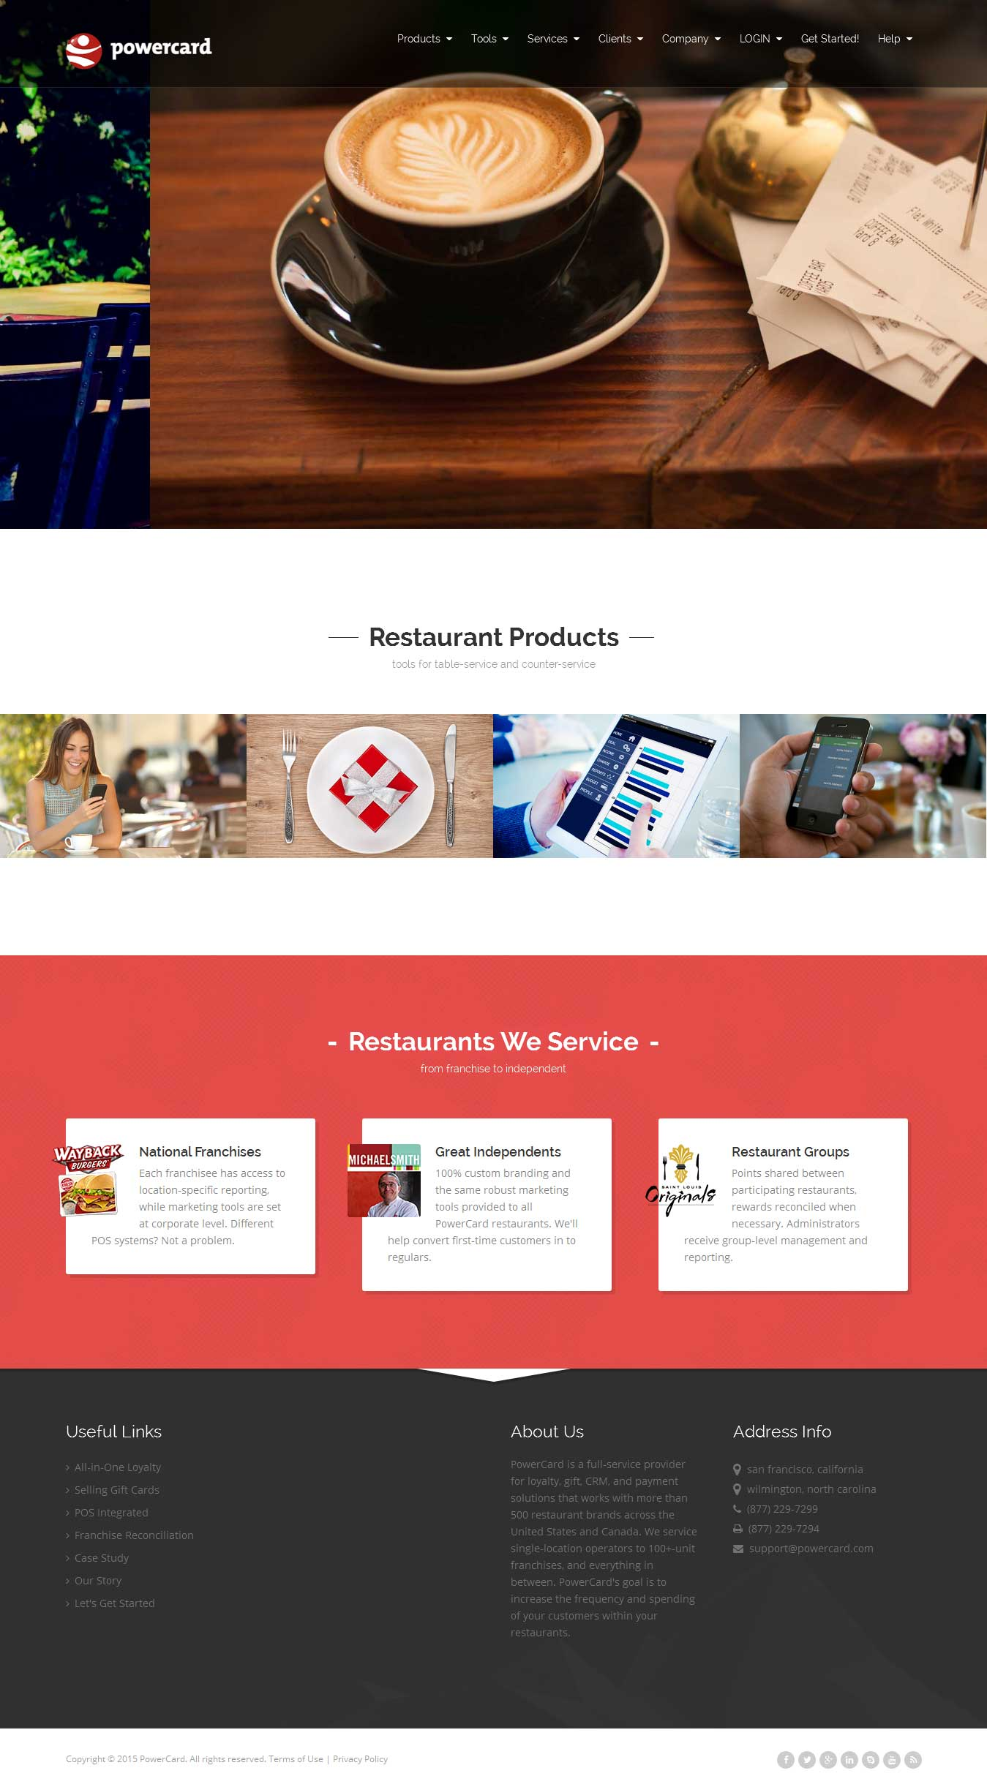
OUR
WORK
Designed & Developed
Angular JS
Project Name: Power Card
Link: http://powercard.com/
Other:
http://www.jobs.cz/
http://bingocardclub.com/
http://bingocardclub.com/
http://www.jobs.cz/

Slide 14
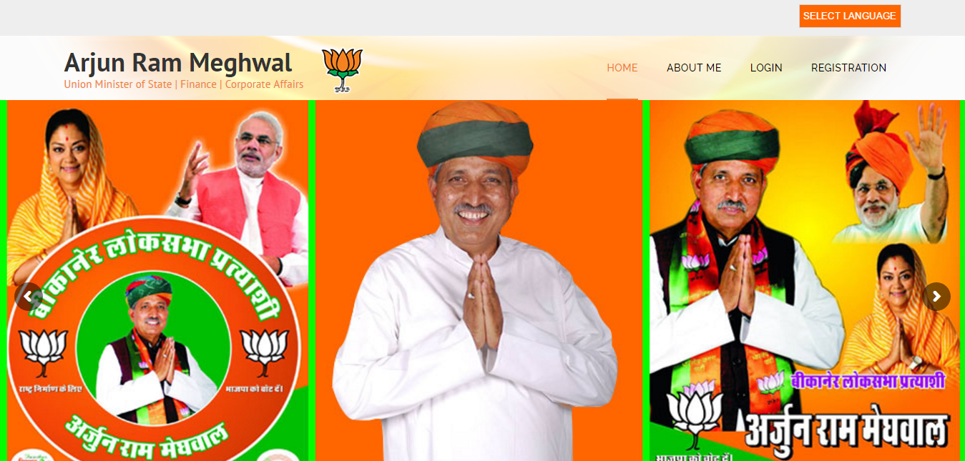
Wordpress
Link: http://techsparksit.com/union-minister/

Slide 15
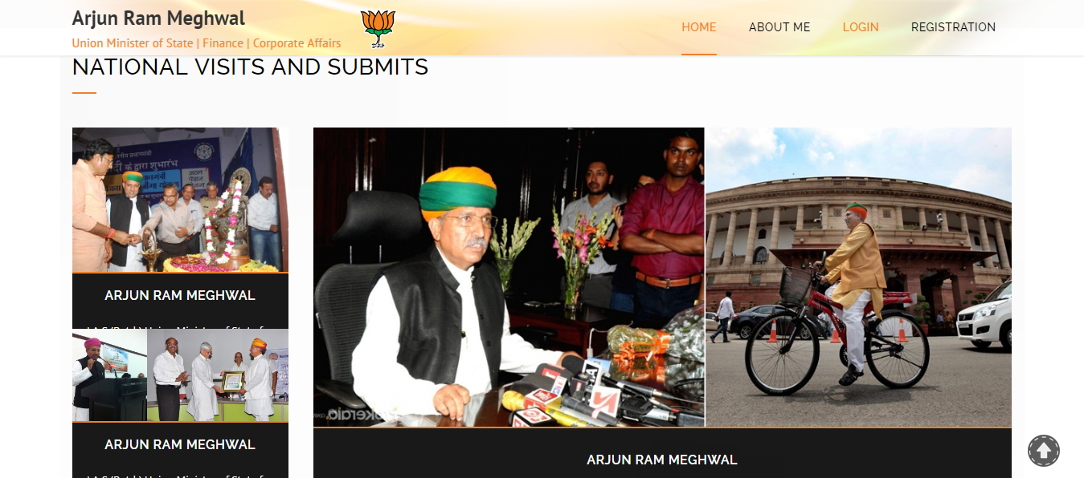
Wordpress
Link:http://techsparksit.com/union-minister/

Slide 16
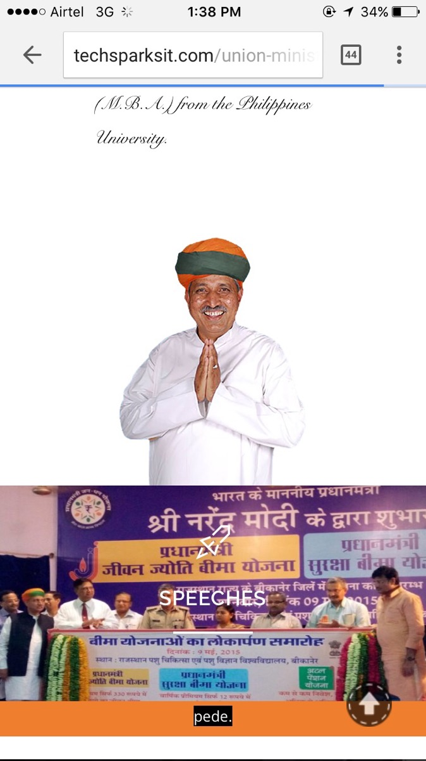
Mobile View
Wordpress
Link: http://techsparksit.com/union-minister/

Slide 17
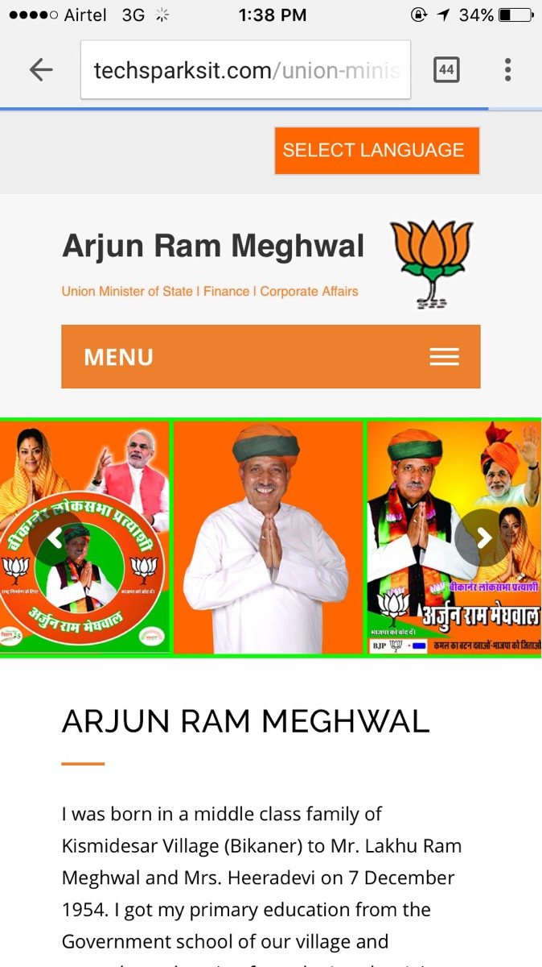
Mobile View
Wordpress
Link: http://techsparksit.com/union-minister/

Slide 18
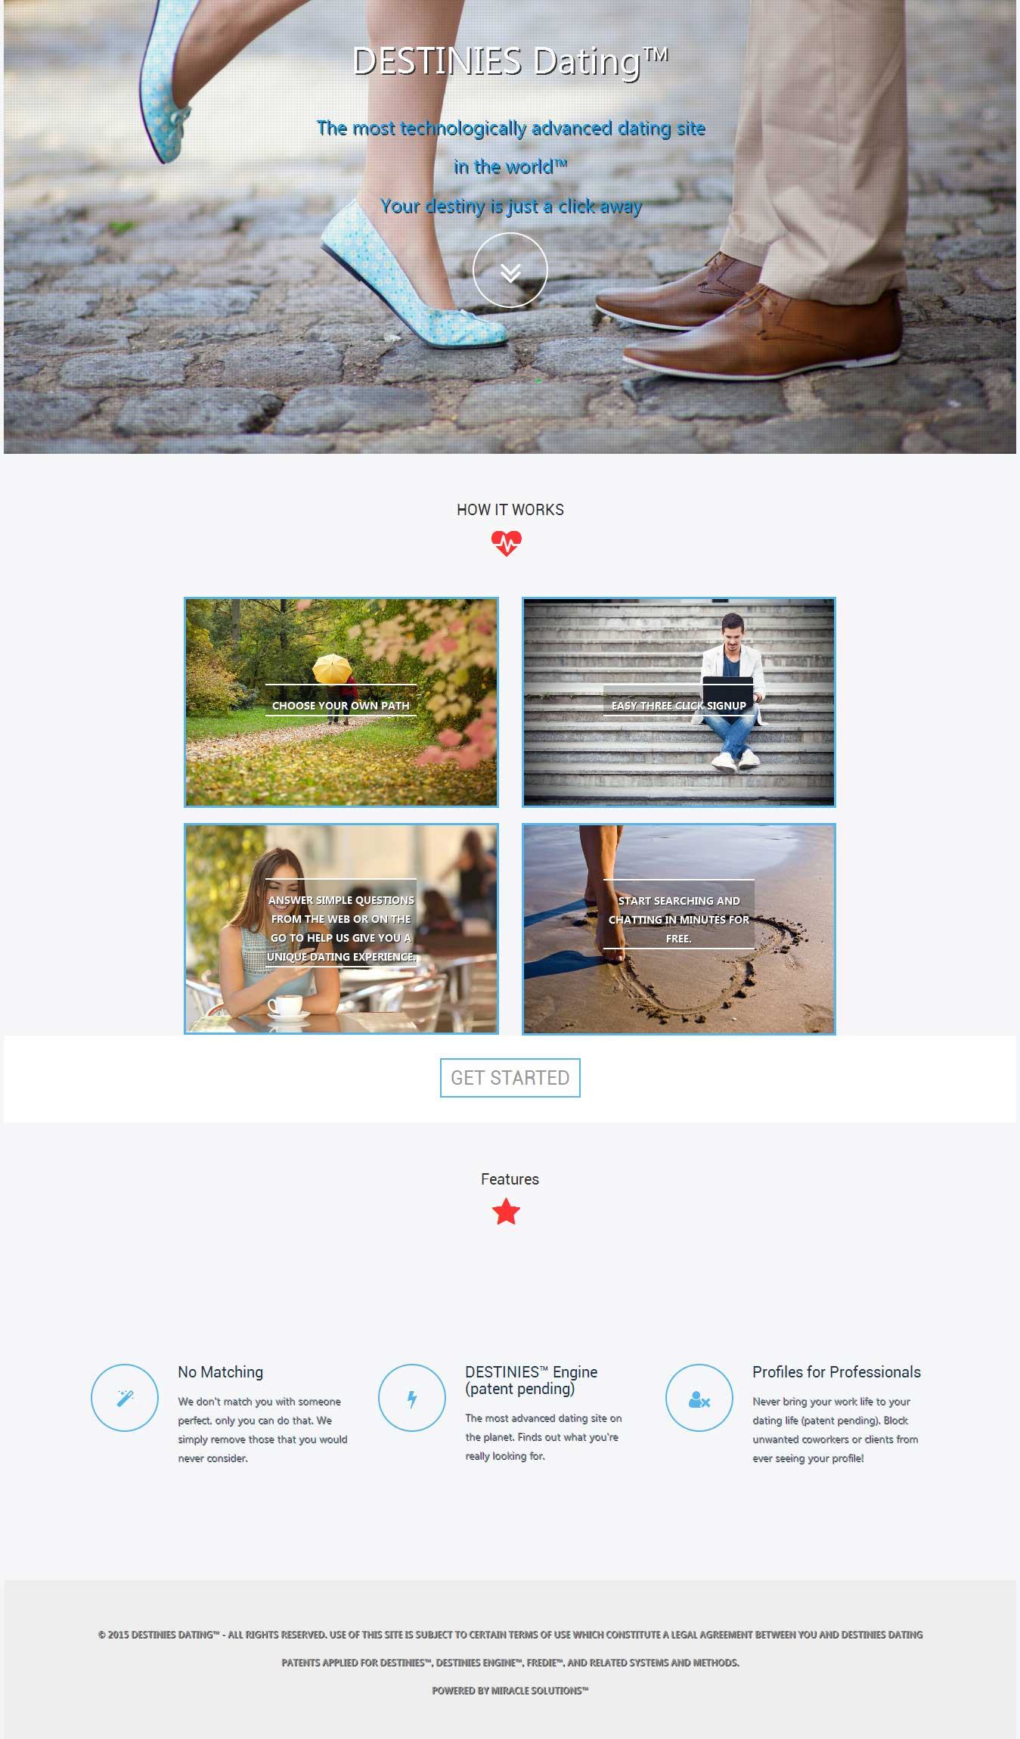
Node JS
Project Name: Dating Site Others:
Link: http://www.destiniesdating.com/ http://www.epicurious.com/
https://www.neobux.com/

Slide 19
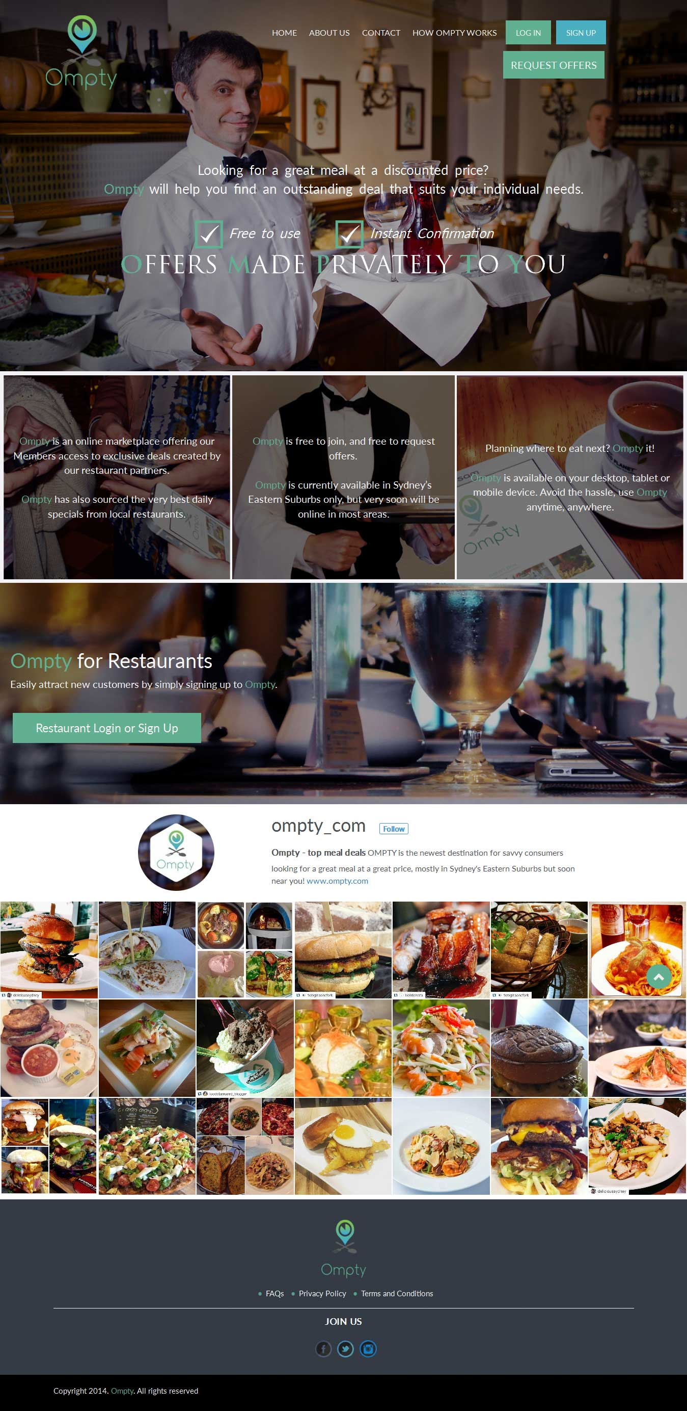
Laravel
Project Name: Ompty Others:
Link: www.ompty.com https://reprevive.com/
http://vc.blmco.com/user/login

Slide 20
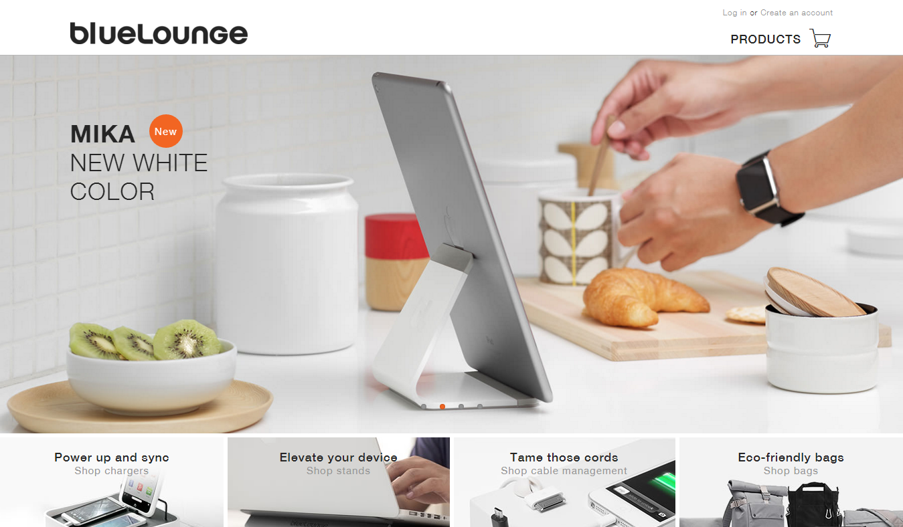
PHP
Project Name: Blue Lounge Others:
Link: http://www.bluelounge.com/ http://egcharge.com/ http://www.indochino.com/

Slide 21
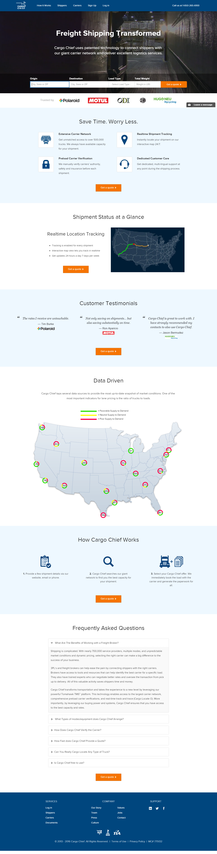
Codeigniter
Project Name: Cargo cheif Others:
Link: https://www.cargochief.com/ http://likethis.net/ http://sagitus.com/sagitus2014/

Slide 22

Cake PHP
Project Name: Wreck Check Car sScan Others:
Link: http://www.wreckcheckcarscan.com/ http://www.doubleoar.com/

Slide 23

IOS APP
Project Name: Pagal parrot
Designed & Developed

Slide 24
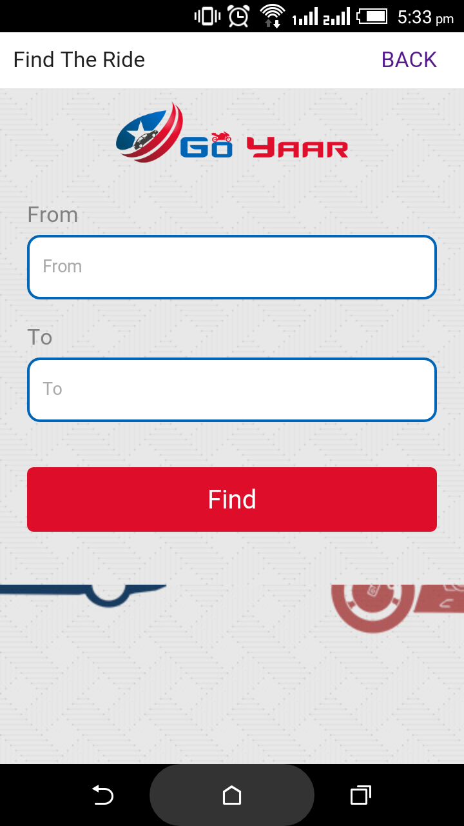
ANDROID APP
Project Name: Go yaar
Designed & Developed

Slide 25






OUR
LOGO DESIGNS

Slide 26

Portfolio
SEO
Techsparks has been successful in creating its mark among the major Institutes For Thesis which are indulged in guiding the M.tech thesis project students residing in different corners of the world.
techsparks.co.in
Keywords | Ranking
M.tech thesis in Chandigarh | 1
M.tech and PHD thesis help in Chandigarh | 1
Online thesis help in Chandigarh | 1
Thesis help in Chandigarh | 1
M.tech thesis help | 1
Dissertation help Chandigarh | 1
M.tech thesis services in Kurukshetra | 1

Slide 27

Achievers Resource Solutions are recruitment professionals who aim to go beyond expectations for both clients and candidates. We see ourselves as playing an integral role in the strategic growth of our clients' businesses.
achievers.ie
Keywords | Ranking
Permanent Recruitment Services | 1
Employers managed services | 1
Temporary or permanent contract recruitment services | 3
Permanent recruitment solutions | 3
Temporary and contract recruitment | 8
Permanent recruitment process dublin | 9

Slide 28

EVENTup provides the tools to find exactly what you are looking for. You can browse by market, narrow down by capacity, filter by a wide array of amenities, and much more.
eventup.com
Keywords | Ranking
Space for events dallas | 1
Corporate event venue houston | 1
Space for corporate events houston | 1
Space for corporate events boston | 1
Space for events washington | 1
Social event venues philadelphia | 1

Slide 29
Protech Hospitality Hub is a collaboration of Designers, Hospitality fitout and Equipment specialists, working together with you, to create bespoke Hospitality solutions
protechhospitality.com.au
Keywords | Ranking
Hospitality fitouts and commercial kitchens | 1
Hospitality and commercial kitchen fit outs | 1
Protech hospitality fitouts and commercial kitchens | 1
Protech hospitality interior design | 1
Protech hospitality design | 1
Protech hospitality equipment | 1

Slide 30
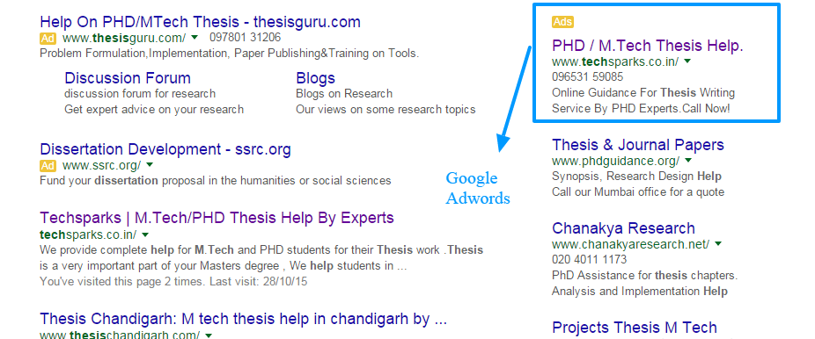
Google
ADWORDS

Slide 31
LIFE IS AN ADVENTURE WORTH SHARING!
Email: akash@techsparksit.com
Website: http://techsparksit.com/
Facebook: https://www.facebook.com/ techsparksit

Slide 32
LET’S WORK
TOGETHER
We’d love to discuss your project, quote or creative pitch so please get in touch.
Call us, on + 917696666022 email us at akash@techsparksit.com or send us a message.
If you would like to view some of the projects we have undertaken please visit www.techsparksit.com
There is always something new we are working on !

Slide 33
TECHSPARSKIT
D-185, PHASE 8B Industrial Area, Mohali +917696666022

